Slide 1
AI Strategy and Governance
Is AI and Data Analytics Suited for Innovation?
Lynn Wu, Associate Professor of Operations, Information and Decisions

Slide 2
AI Innovation: Halicin
Is AI and data analytics suited for innovation?
In 2020, AI helped create a new antibiotic called Halicin
Big breakthrough because new antibiotics are extremely difficult to find
This has become a public health issue as “superbugs” are becoming a big problem
MIT research scientists leveraged data about drug compounds with anti-bacterial activities
After screening more than 100 million compounds, they were able to discern new patterns from the data that we hadn’t seen before
They were able to identify a new antibiotic candidate in just three days

Slide 3
AI Innovation: Halicin
Halicin is unique in several aspects
Discovered through AI platforms with the aid of scientists
Not only is it very effective, Halicin is distinct from other types of antibiotics in its chemical structure and is tolerated in the human body (nontoxic to human cells)

Slide 4
AI and IBM’s Watson
Watson digested 23 million medical papers across many different disciplines to find information about a tumor suppressor know as p53
p53 is associated with half of all cancers
In a short amount of time, Watson was about to identify six previously unknown proteins that interact with p53
This feat would have taken researchers more than 6 years to accomplish

Slide 5
AI and Product Design: Autodesk
Autodesk was trying to design a new type of chassis
Added many sensors to the a chassis that measured stresses, strains, temperatures, displacements, and all the other things that chassis need to accommodate
After the sensors were installed, a stunt driver drove the car to really push the system — accelerating, braking, and steering as hard as possible

Slide 6
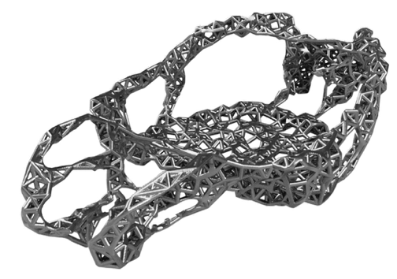
AI and Product Design: Autodesk
After 20M data points, AI (with the aid of scientists) came up with a new chassis
Doesn’t really look like a car — resembles the bones of a mammoth
Notice the asymmetry — the left hand side and the right hand side are not mirrors of each other
If you look at the data, it was found that the car turns more often in one direction that the other

Slide 7
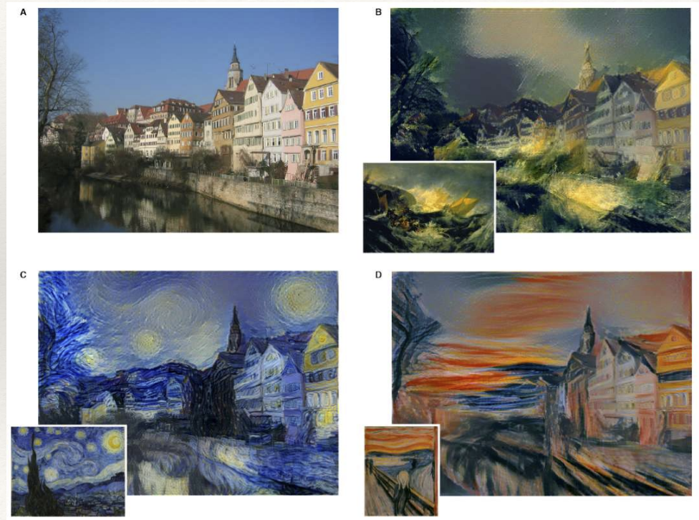
AI in Art

Slide 8
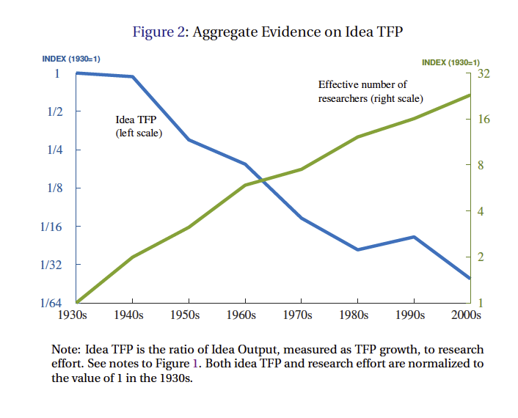
Some Argue We Are in an Innovation Winter
Idea TFP = total factor productivity growth / R&D expenses
Bloom et al 2017

Slide 9
AI Innovation Paradox
Why do we see so many AI driven innovations, but they do not show up in our productivity and innovation statistics?
Central question — what AI can do and cannot do for innovation

Slide 10
AI Strategy and Governance
AI and Process Innovation
Lynn Wu, Associate Professor of Operations, Information and Decisions

Slide 11
Big Data and Process Innovation
The explosion of big data is ripe for advanced AI and data analytics techniques
Explosion of text, pictures, video, sound
Much of the data can come from business processes
Once firms can carefully curate their business process data and analyze it with advance machine learning analytics tools, this can lead to dramatic improvements in process innovation

Slide 12
Google Data Centers
Google runs some the world’s largest data centers
They are extremely energy-intensive, supplying power to 100,000 servers while also keeping them cool
The cooling challenge is compounded by the fact that the facility’s computing load varies quite a bit
Humans typically control the pumps, coolers, cooling towers, and other equipment that keep data centers at the right temperature
Wanted to see whether machine learning could be used

Slide 13
Google Data Centers
They took years of historical data on data centers’ computing load, sensor readings, and environmental factors like temperature and humidity
Used all of this information to train a set of neural networks to control all of the available cooling equipment

Slide 14
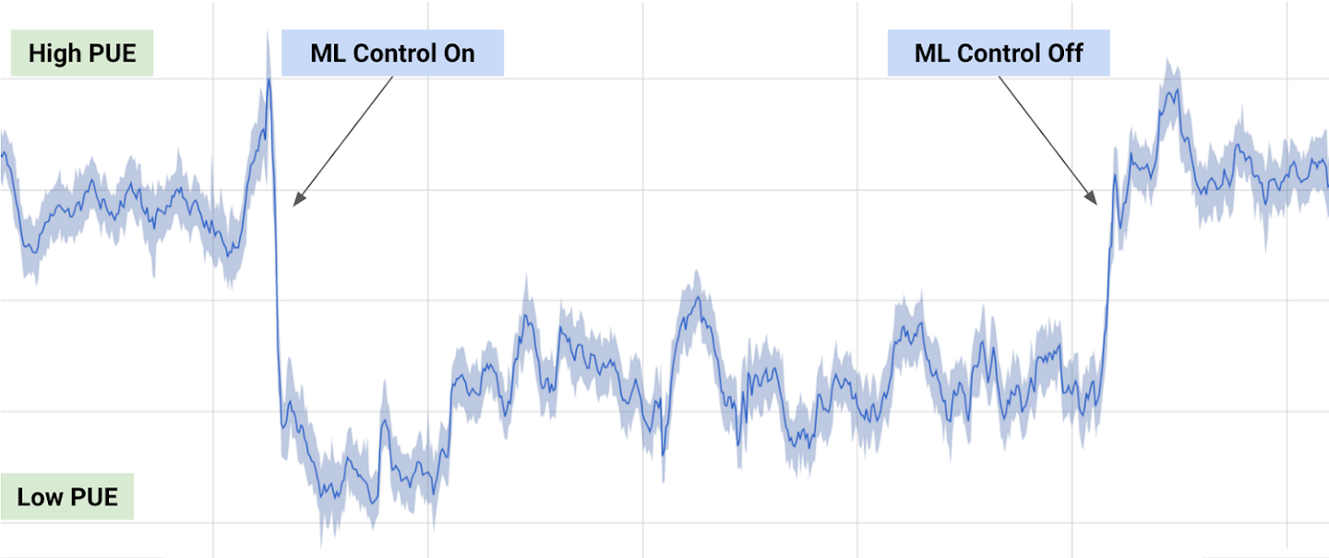
Google Data Centers
PUE=Power Usage Effectiveness
After the system was deployed, energy used fell 40% and the overhead associated with this energy use improved by 15%

Slide 15
Other Examples
Amazon and other firms have used ML to improve product recommendations and the process of managing inventory
Infinite Analytics uses ML to predict which ads a user will click
Cybersecurity firms, such as Deep Instinct, use process data to better detect malware
In many cases, they can predict the malware before an actual security breach has happened
Insurance companies use ML to analyze customer data to improve customer support

Slide 16
Large Survey of Firms on Process Innovation
8 questions, answered on a scale of 1-5, about how likely a firm is oriented to improve their process innovation
“To what extent do the following statements describe the work practices and environment of your entire company”
“We have a strong ability to make incremental changes or improvements to our business processes”
“Please list the most important core activities for your primary business”
Looking for answers like process development, process quality, process management and improvement
“How is your organization proactively engaging with business leaders to refine existing processes and systems?”

Slide 17
Distribution of Process-Oriented Practices

Slide 18
Data Analytics/AI Measurements
Taxonomy used to classify data analytics skills
General: | Business intelligence, Data analysis, Data center, Data driven, Data fusion, Data integration, Data mining, Data warehouse
Algorithms & Methodology oriented: | A/B test, Ensemble learning, Genetic algorithm, Machine learning, Natural language processing, Neural network, Network analysis, Optimization, Pattern recognition, Predictive model, Regression, Signal processing, Simulation, Supervised learning, Unsupervised learning, Visualization
System oriented: | Cassandra, Cloud computing, Distributed system, Hadoop, HBase, Google File System, MapReduce

Slide 19
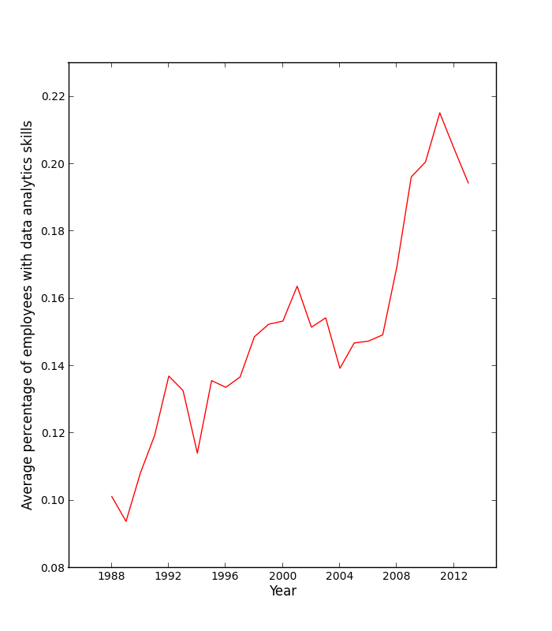
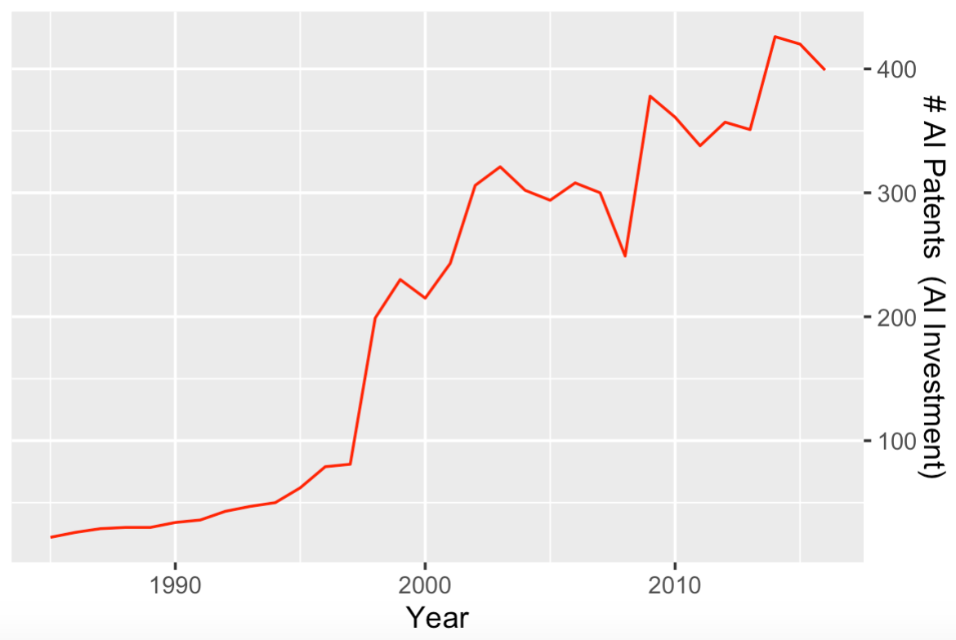
Data Analytics vs. AI Only
Data Analytics
AI Only

Slide 20
What We Find
Data analytics and AI can greatly facilitate process innovation
Firms that use AI tools and are more oriented torward process improvement experience greater productivity gains
One standard deviation increase in investment in AI tools are associated with 7% more productivity
If a firm invested in AI, but was not interested in improving their processes, they would not experience that 7% productivity gain
Only when you have both the investment in AI tools and orientation toward process improvements do you see the productivity gains

Slide 21
AI Strategy and Governance
Product Innovation
Lynn Wu, Associate Professor of Operations, Information and Decisions

Slide 22
Can AI Help with General Product and Service Innovation?

Slide 23
Large Survey of Firms on Product Innovation
7 questions, answered on a scale of 1-5, focusing on innovation-driven practices for products
“How long does it take your organization to design, create and introduce a new product or service?”
“How long does it take your organization to introduce a new production technology?”
“List the most important core activity for your primary business unit”
Looking for answers like product development, product design, innovation

Slide 24
Distribution of an Emphasis on Product Innovation

Slide 25
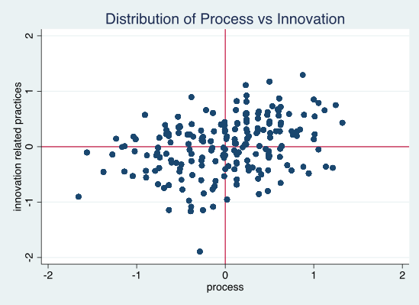
Process vs. Innovation Practices

Slide 26
Propensity to Invest in AI and Data Analytics

Slide 27
Productivity Differences
7% more productive

Slide 28
Findings
Not only is the relationship between AI/data analytics and general product innovation zero, sometimes the relationship is negative
The more oriented toward product and service innovation you are, the less likely you are to invest in AI
The relationship between AI/data analytics and process innovation is positive
The more process innovation oriented you are, the more likely you are to invest in AI
Furthermore, you are reaping rewards from that investment by becoming more productive

Slide 29
AI Strategy and Governance
Different Types of Product Innovation
Lynn Wu, Associate Professor of Operations, Information and Decisions

Slide 30
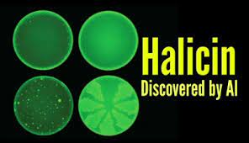
Recombination in Innovation

Slide 31
Recombination in Innovation

Slide 32
Recombination in Innovation

Slide 33
Recombination in Innovation

Slide 34
Recombination in Innovation

Slide 35
Recombination in Innovation

Slide 36
Recombination in Innovation
AI analytics can drastically expand the search space for you to find new innovations
By doing the linkage to detect hidden patterns among data, we’re able to find new ways to combine existing technologies in a new way

Slide 37
What Kind of Product Innovation Can AI Support?
Diverse recombination — combining many technology elements together in a new way
Example: You have four existing technologies, “A”, “B”, “C”, “BC”
A diverse recombination would be something like “ABC”
A novel or radical innovation is “D”
This is a technology class that has not existed before

Slide 38
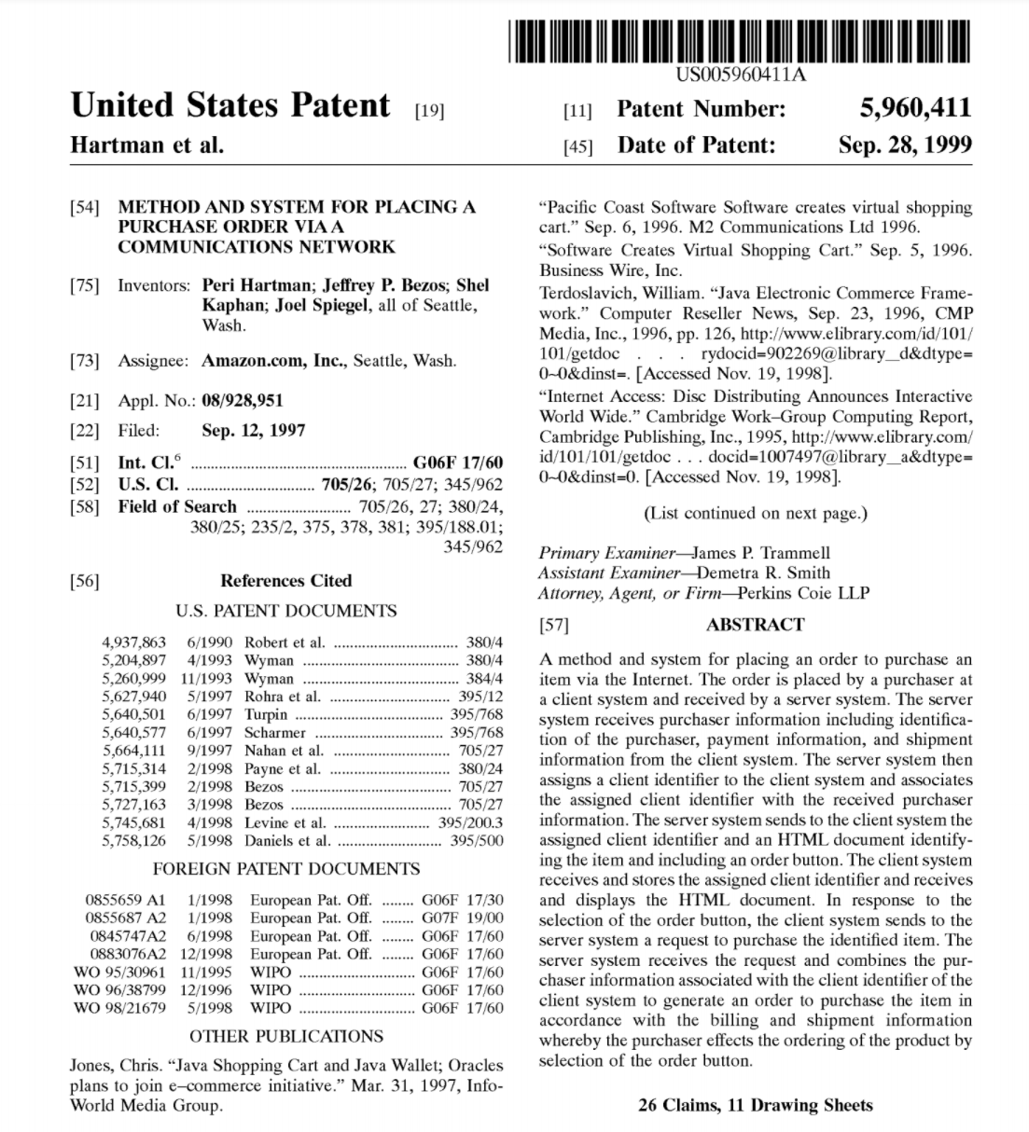
Patents
A patent has a specific classification code
We also know the patents that the current patent has cited

Slide 39
Patents
If a patent has 10 citations, all belonging to the same patent technology class, then we know it’s not a diverse combination
But if the 10 cited patents are coming from 10 different technology classes, then it’s likely this patent is more of a diverse combination

Slide 40
Patents
To measure novelty we can look at the abstract of the patent to see whether the words used are new
Example: The first time the word “HTML” showed up in an abstract, that patent was probably very novel

Slide 41
Patents
Use patent data and classify each patent into:
Diverse recombination (a combination of many technology classes together, e.g. “ABC”)
Novel technology class (e.g. “D”) or words that have not been seen in other patents before
Then we examine the relationship between AI investments and these two different types of product innovation

Slide 42
Propensity to Invest in AI/Analytics

Slide 43
Productivity Effects
“ABC”
“D”
“ABC”
“D”

Slide 44
Main Takeaways
We find data analytics and AI support diverse recombination of existing technologies (“ABC”)
Data analytics and AI do not support radical new technologies (“D”)
Firms that invest in data analytics/AI and focus more on recombination in innovation are more productive than firms that do not invest in data analytics/AI

Slide 45
AI Strategy and Governance
Organization Factors
Lynn Wu, Associate Professor of Operations, Information and Decisions

Slide 46
AI, Innovation, Organization Change
Other organizational factors may affect the relationship between AI analytics and recombination innovation
How you organize your innovation may mediate that relationship
Some organization structures are just well suited to support AI driven innovation and some organization structures are not
Will explore whether organizational factors such as how you organize your innovation teams, team composition, and the skill set of employees could change the type of innovation that AI can help firms create

Slide 47
AI, Innovation, Organization Change
Organizations have very different ways of organizing their activities
They may organize their general activities in one way, and they may organize their innovations in another way
This structure can both vary within industries and across industries

Slide 48
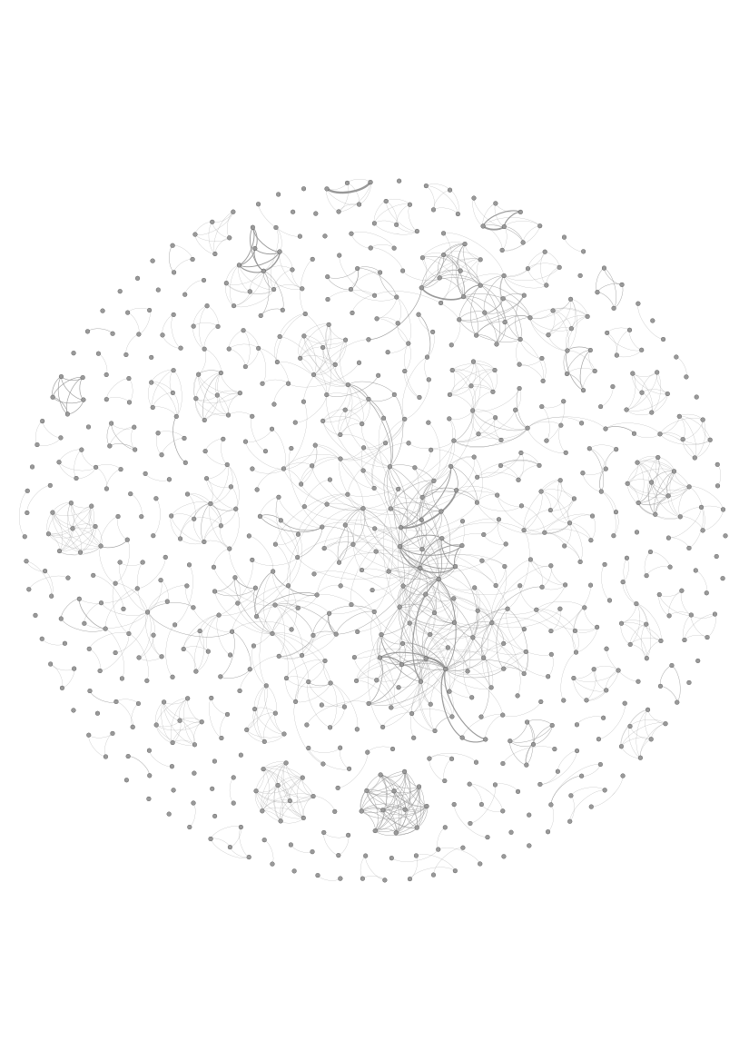
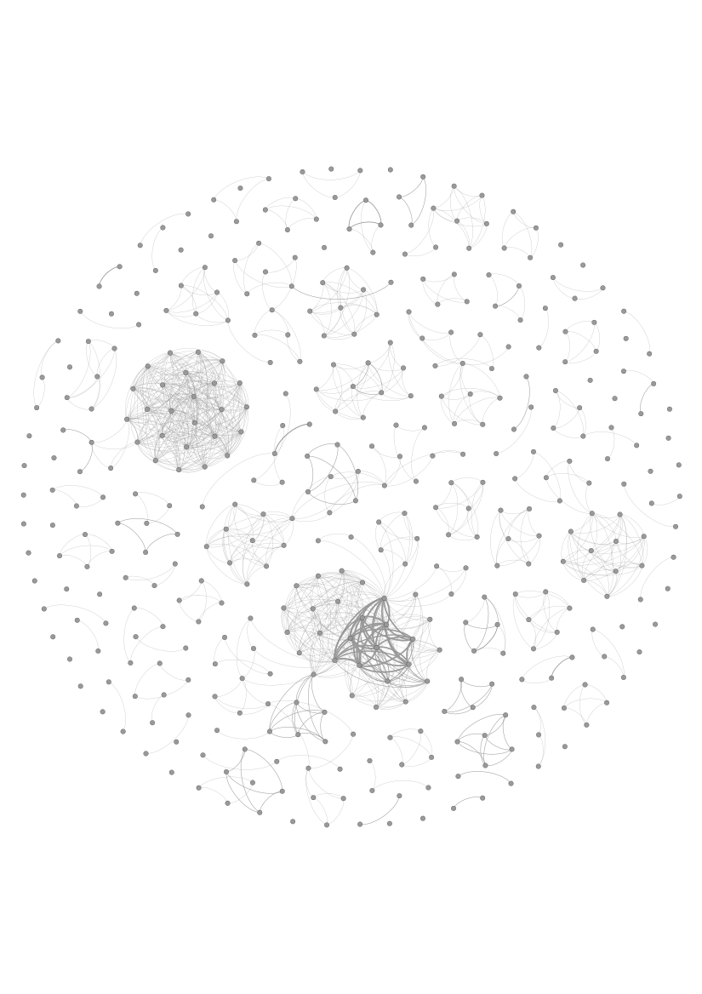
Can Data Analytics Help Google or Apple More to Innovate?
Google
Apple

Slide 49
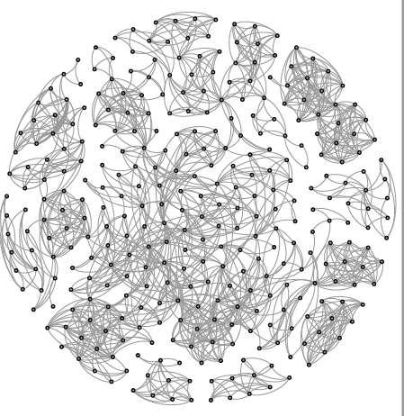
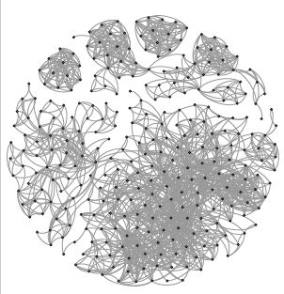
Can Data Analytics Help Sanofi or Roche More to Innovate?
Sanofi
Roche

Slide 50
Pros and Cons of Centralization vs. Decentralization
Decentralization
Centralization
Better at evaluating local market and “sticky knowledge”
Radical innovation applicable beyond individual research group
More involved with operations and identify problems and alternative solutions
Broad search for external information beyond individual groups
Overcome lack of cross-departmental coordination
Does not facilitate cross-departmental coordination

Slide 51
How Does AI Help Firms with Different Innovation Structures?
Data analytics helps decentralized innovation structure
Mitigating the weakness in broad search for diverse knowledge
Linking silos of information in decentralized structure
Data analytics (AI, ML, etc.) may be especially great at new combinations or reuse of existing combinations
Cancer oncology — links many documents together to find new cancer targeting proteins (p53)
New chassis — link sensor data with traditional data to find new design
Art/music — combine different elements of art and music

Slide 52
Measurement: Innovation Structure
Community detection algorithm on the co-authorship network
Basically captures how many groups are there and how connected are they to each other
Dispersed — high measurement of decentralization
Concentrated — high measurement of centralization
Capturing the real way people are working together and innovating together by looking at their co-authorship on a patent

Slide 53
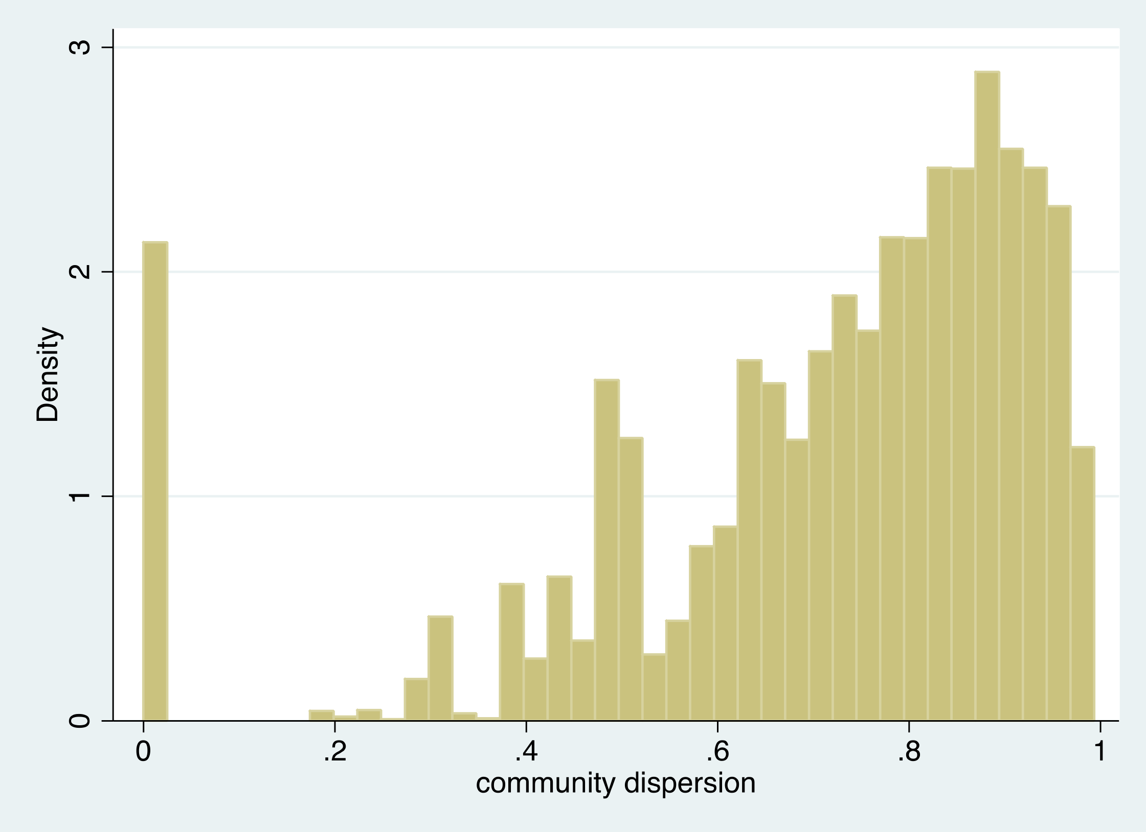
Distribution in the Dispersion of Innovation Structure

Slide 54
Measure Your Own Organization Structure
You can use this to measure your own organization structure
You can see how your formal hierarchy and organization structure differ from the informal collaboration structure (the one that’s actually being done by the employees themselves)
You can also include other innovation products other than patents (e.g. trademarks, product designs, white papers, publications)
You can use this to see how your structure differs from your competitors

Slide 55
Key Takeaways
Data analytics complements decentralized innovation structures in firms
Decentralized innovation structures benefit tremendously by having investment in AI and data analytics
Firms with decentralized innovation structures are more likely to adopt AI and data analytics
More productive than firms with only investment in AI or only a decentralized innovation structure (about 3% more productive)
The effect is stronger in more recent years

Slide 56
Measurements: Innovation
Recombination — combining two or more existing technologies to create a new technology
Example: 4 existing technologies, “A,” “B,” “C,” “AB”
New recombination might be “BC” or “ABC”
Reuse, or refinement of existing technology, might be A’, B’, C’
Novel technology that hasn’t existing before, “D”
Innovation outcomes: Patents | Novel technology (text mining & patent class) “D” | New combination “AB”, “BC”, “ABC” | Reuse A’, B’, C’
Global
Local to firm

Slide 57
AI and Decentralization

Slide 58
AI and Decentralization

Slide 59
AI and Decentralization

Slide 60
AI and Decentralization

Slide 61
AI and Decentralization

Slide 62
AI and Decentralization

Slide 63
AI and Decentralization
4 patents

Slide 64
AI and Decentralization

Slide 65
AI and Decentralization

Slide 66
AI and Decentralization

Slide 67
AI and Decentralization

Slide 68
AI and Decentralization

Slide 69
AI Supports Decentralization
3% more productive

Slide 70
AI Strategy and Governance
Dispersion of Employees
Lynn Wu, Associate Professor of Operations, Information and Decisions

Slide 71
AI and Data Analytics Skills
What kind of skills should a firm pay attention to?
Where should the data analytic skills come from?
How do you organize the skills to best facilitate innovation for your firm?

Slide 72
Where Should AI/Data Skills Come From?
“If AI skills matter for innovation, we should just hire more people with AI skills”
Probably really hard to do and very expensive
Imagine trying to hire a drug innovation expert who is also well versed in AI — probably pretty hard to find
Could just hire anyone with AI skills
If so, where would you put them?
Does it matter if you have inventors who have AI skills, or can you just hire anyone with AI skills and have them help researchers use AI for discovery?

Slide 73
Data Skills for the Inventors?

Slide 74
AI Skills
You don’t need to hire people with AI skills who are also inventors
You can hire people with AI skills who can help inventors utilize AI skills — to help them discover what they need to do, and help them achieve their innovation goals

Slide 75
Centralizing vs. Decentralizing AI Skills
Should AI skills be concentrated in a single department or should they be embedded within different functional departments?
Not easy to answer, because firms tend to do this both ways

Slide 76
Example: Twitter
Twitter at first centralized their AI skills in a single department
Created many tools and products that would help other teams at Twitter
Most product teams did not find the tools that the centralized AI teams created very useful
After a few years, Twitter decentralized their team by embedding AI skills within functional teams to help each product team reach their goals using AI

Slide 77
Example: General Electric
Most optimal for General Electric to pair an industry expert with someone with high AI skills to jump start their product innovation
Industry experts can provide the intuition and expertise, and provide enough context and problems that are relevant to the company
People with AI skills can help that person solve the problem, figure out what data to use, how to implement it, etc.
At first, GE centralized AI skills and found it did not work very well
GE later decentralized their configuration by pairing an industry expert with a person with AI skills

Slide 78
Should You Decentralize Your AI/Data Skills?
We looked at the dispersion of data skills across 7 functional groups typical in most firms
Manufacturing
Engineering
Sales and marketing
Human Resources
Accounting and finance
R&D
Administrative

Slide 79
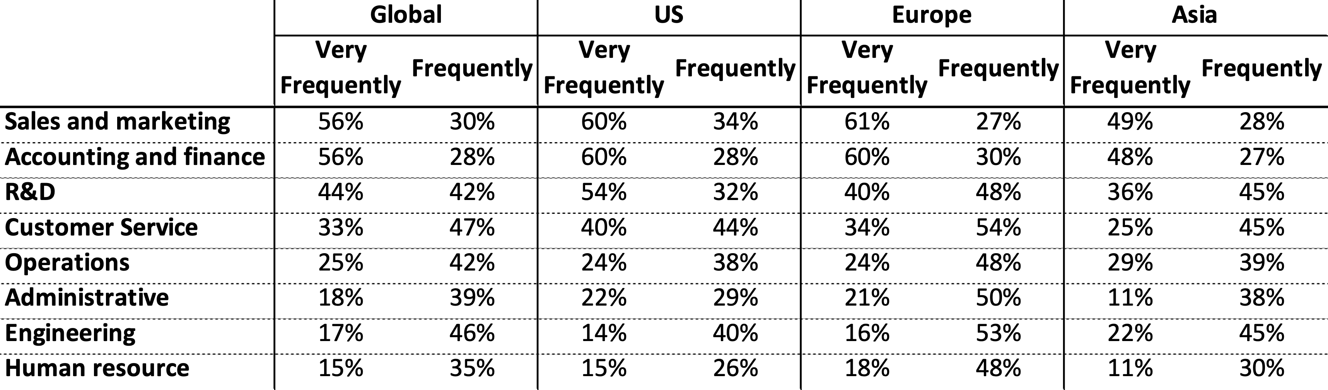
600 Firm Survey
To what extent you do you use data analytics in each of the following groups?

Slide 80
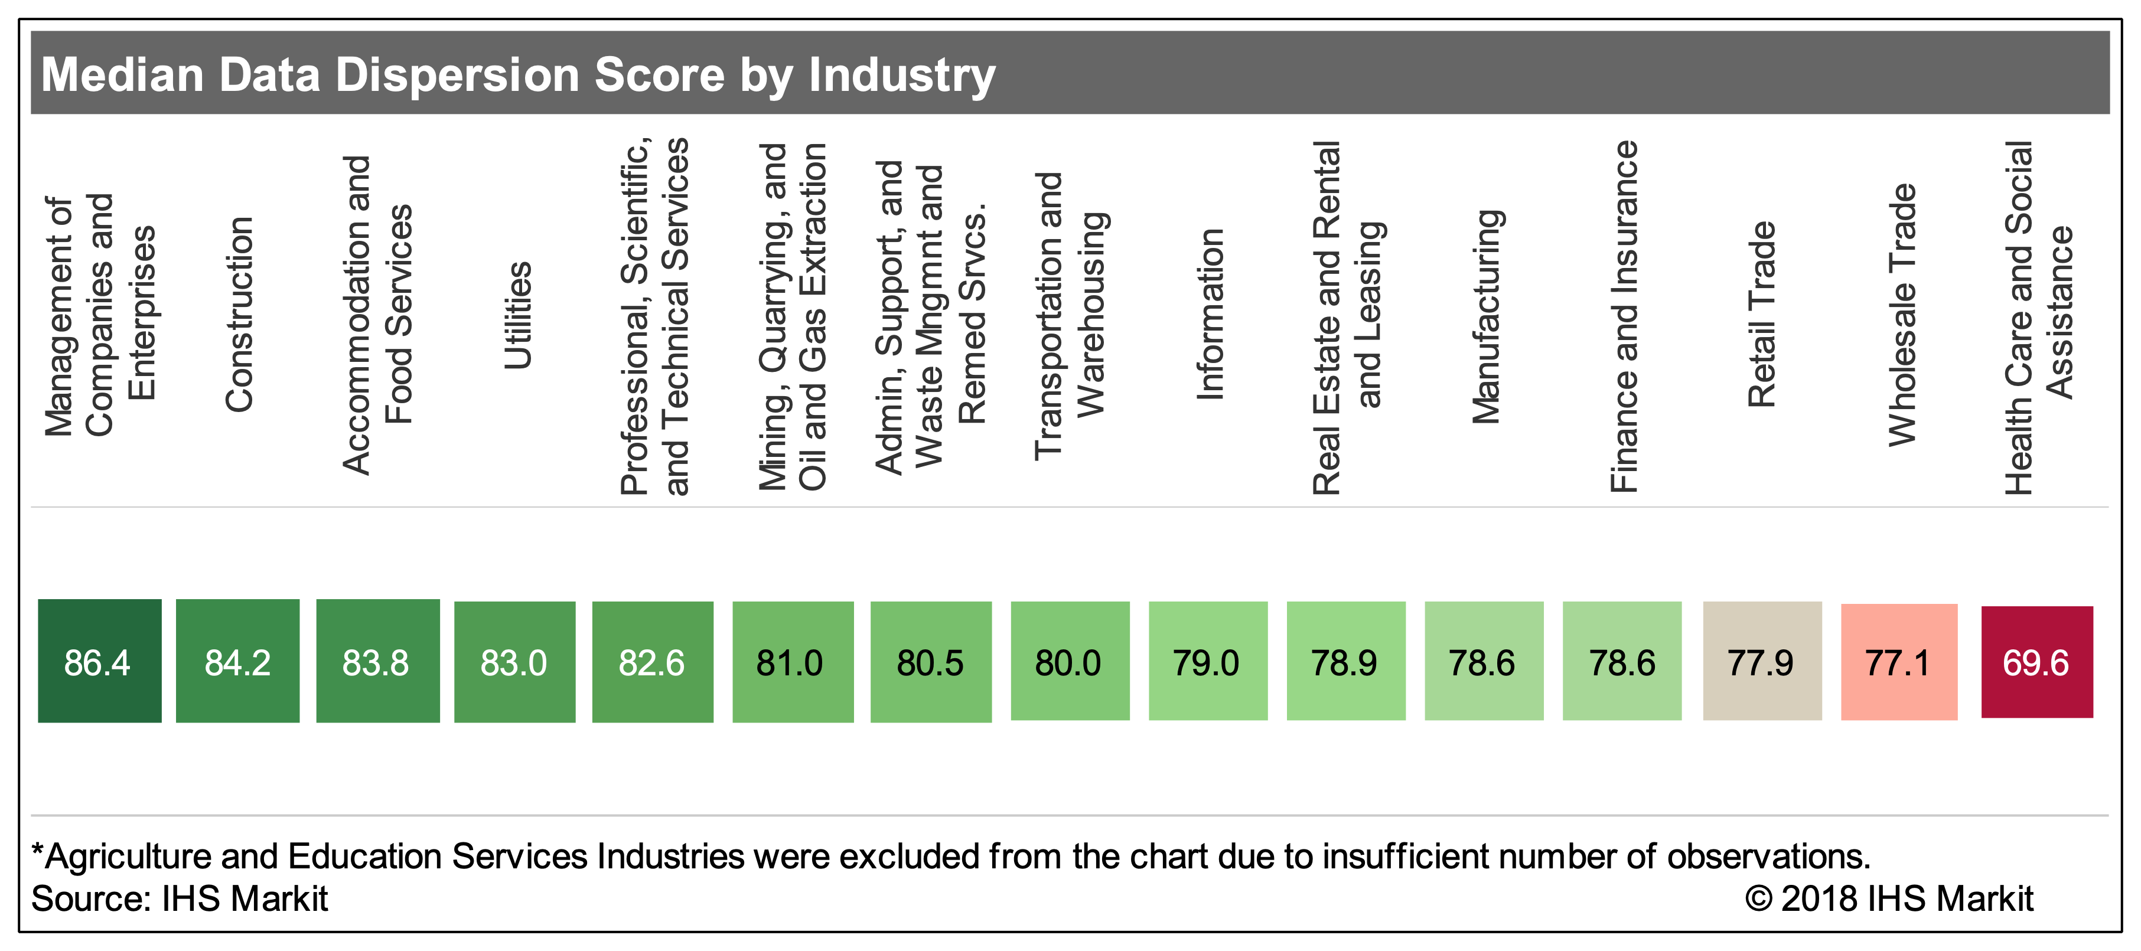
Dispersion Scores By Industry: Range 1-100

Slide 81
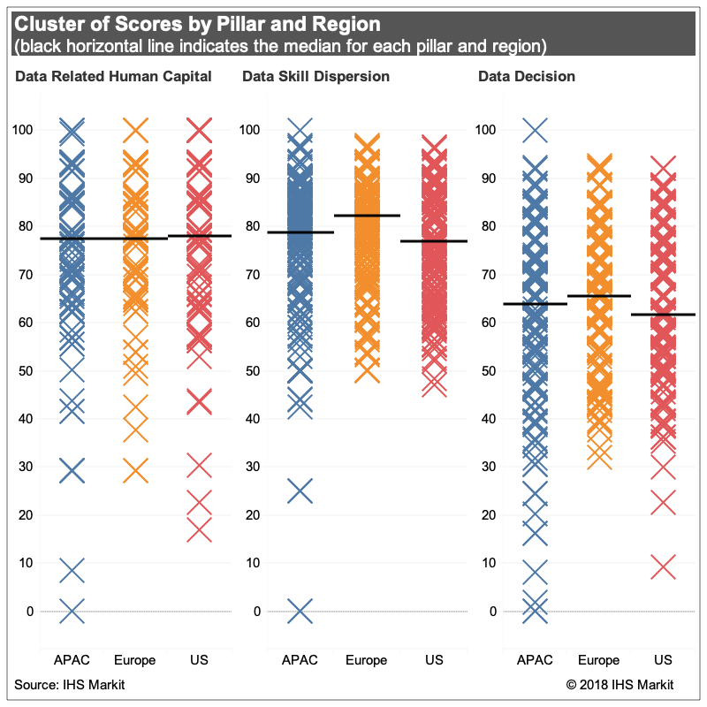

Slide 82
Findings
To what extent is this dispersion actually beneficial to firms?
Firms that disperse AI and data analytics skills across functions are far more productive than firms that did not
Firms that are one standard deviation above the mean in dispersion score have a 3%-5% higher enterprise value
Given the large size of most of the firms in the sample, a 3-5% change in enterprise value for the median sized firm in our sample ($10.7 Bn enterprise value) is between $320 and $534 million

Slide 83
AI Strategy and Governance
Managerial Practice
Lynn Wu, Associate Professor of Operations, Information and Decisions

Slide 84
Managerial Practice Change Associated with AI and Robots
Managerial practices and employee management practices associated with AI
Growth in AI related investment has been rapid
How does that change the employee composition?
How should managers react to the growing investment in AI?
What organizational practices are needed to accommodate the change?

Slide 85
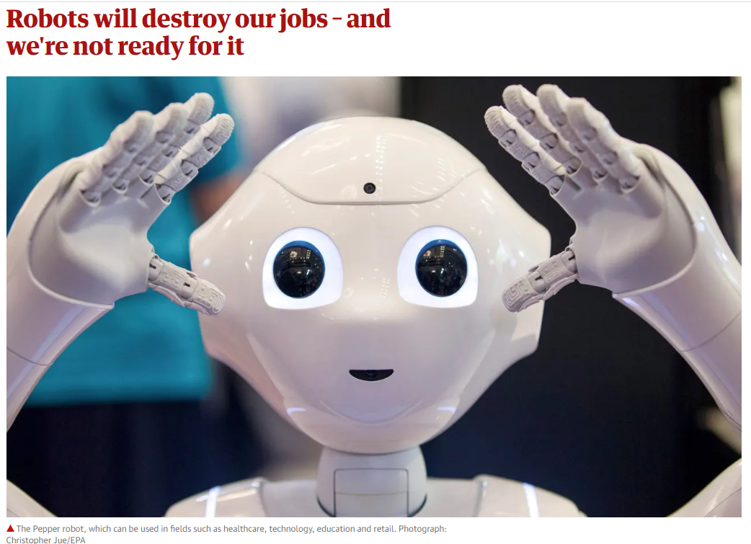
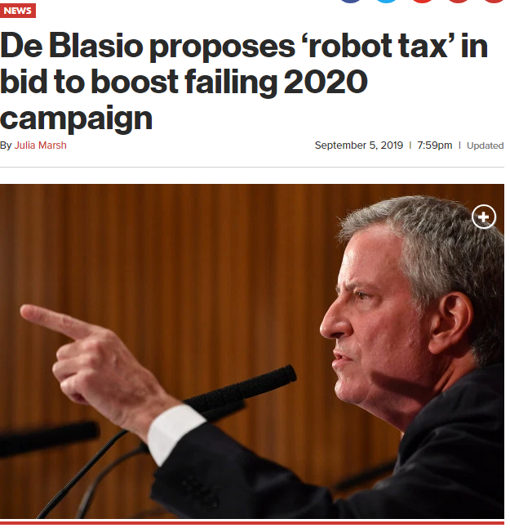
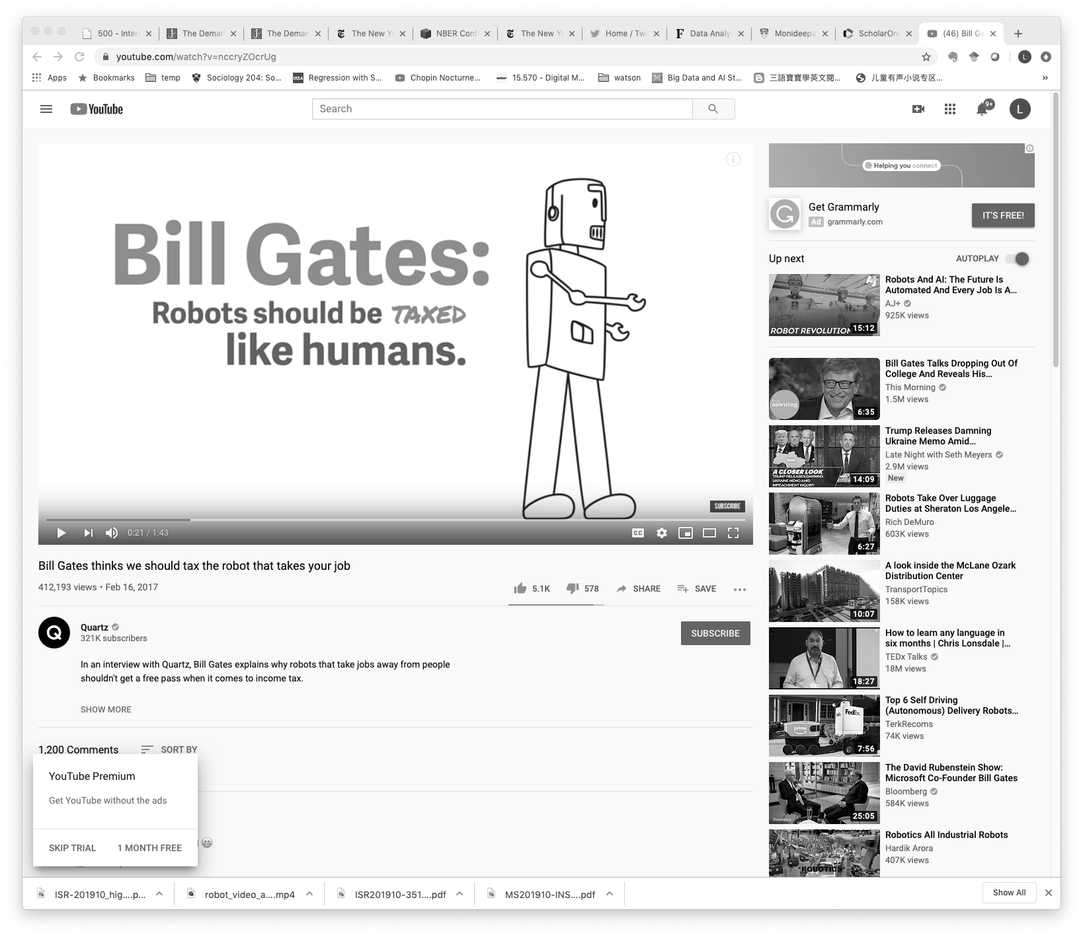
AI and Robots in Employment and Managerial Practices

Slide 86
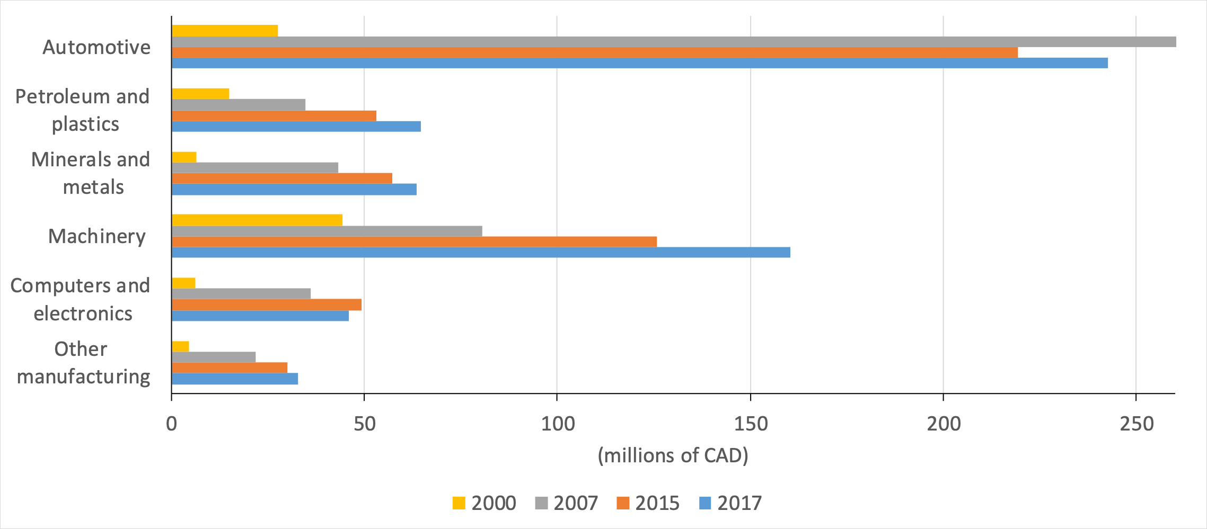
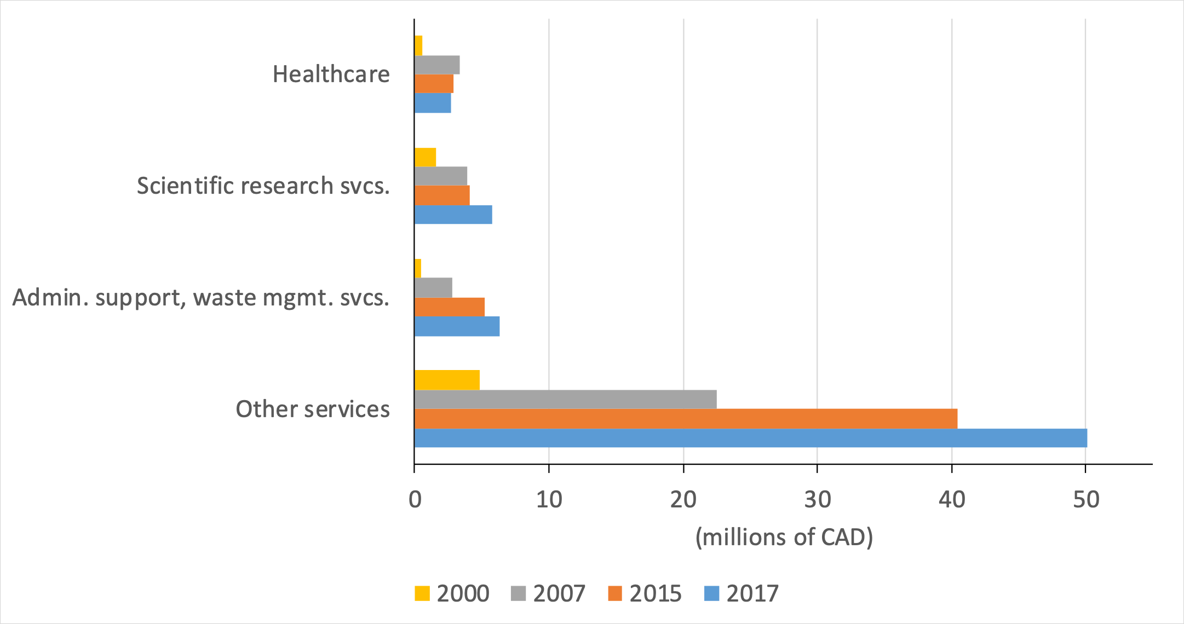
Robot Adoption for Manufacturing and Services
Manufacturing
Services

Slide 87
Robot Adoption
Robot adoption has increased dramatically over time
AI may mirror that adoption pattern and the growth may be even faster
Productivity associated with robot adoption is 10x more than its factor share
Dispersion is quite high — some firms do really well with robots and some firms don’t
That suggests complementary organizational changes are happening associated with robot adoption

Slide 88
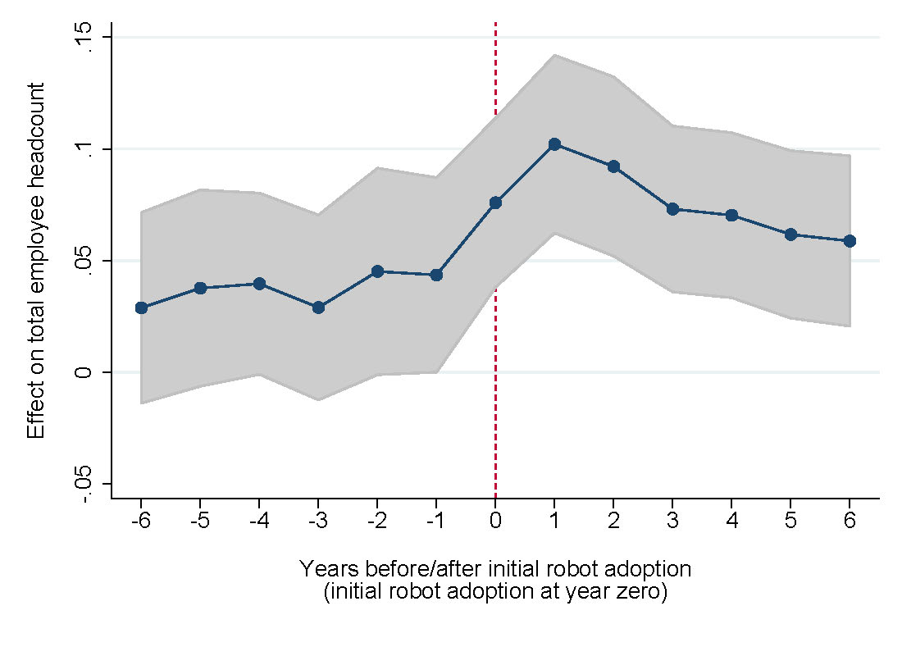
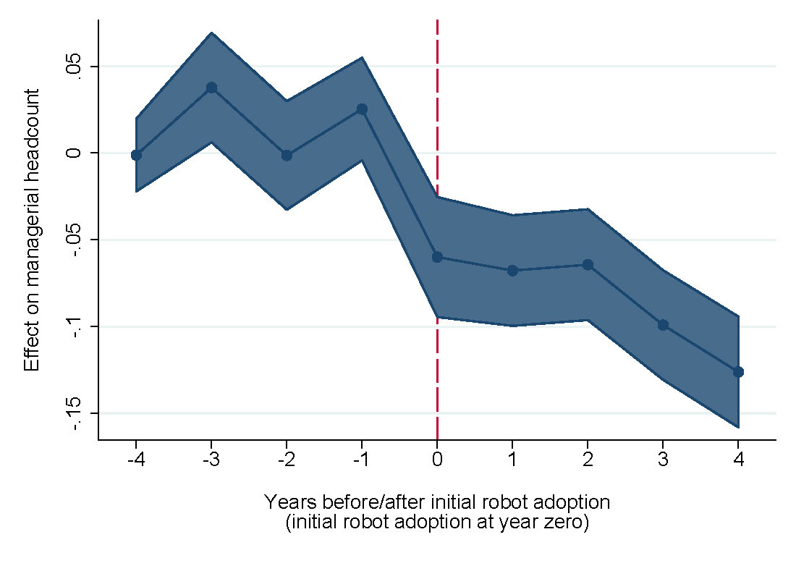
Managerial vs. Employment Change
Total employment (left), managers (right) and robot investment, time indexed regression plot

Slide 89
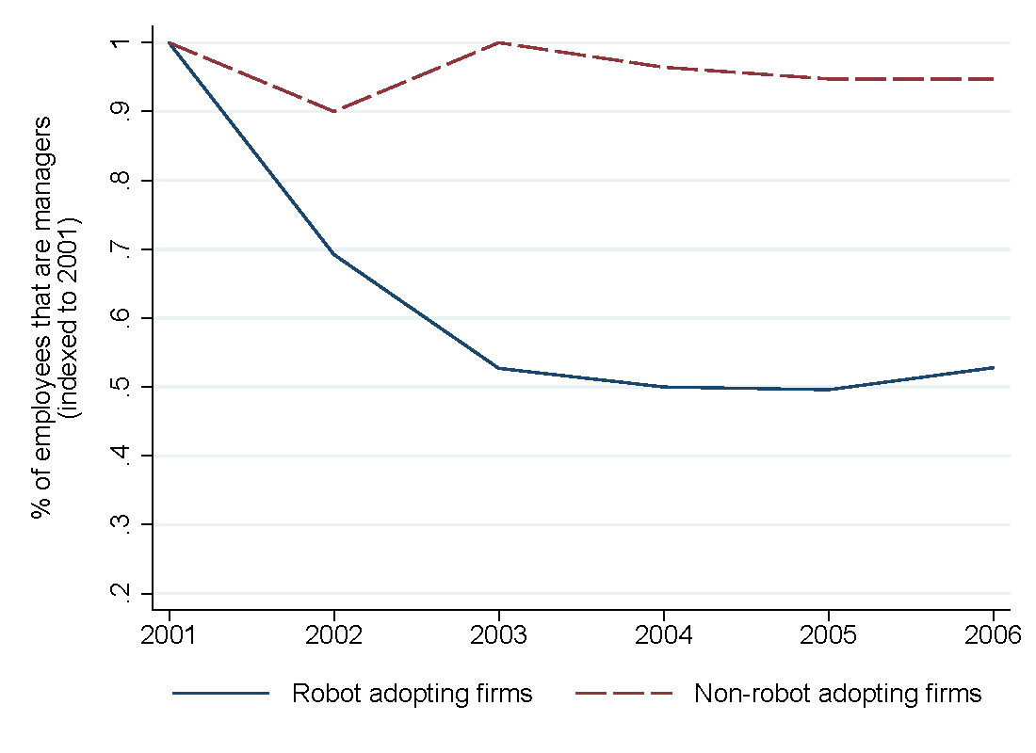
Managerial Employees

Slide 90
Why Managers?
Rate the following factors with respect to their relative importance in your workplace general business strategies
Reducing labor costs
Improving products/services

Slide 91
Why Managers?

Slide 92
Robot Adoption and Employment Composition

Slide 93
Evolving Role of Managers
When you have such a large change in employment composition, the type of managers you need will also need to evolve
What it means to manage high and low skill workers is going to be very different from managing middle skill workers
Low skill work is typically very standardized
Example: Picker/packer at an Amazon warehouse
Little training needed, easily monitored
High skill workers are likely experts themselves and may know how to do their jobs better than their supervisors
Managers are probably acting more like an advisor or coach helping them to do their job, as opposed to telling them exactly how to do it

Slide 94
Firm Practices Have Changed From Robot Adoption

Slide 95
Decision Rights Allocation

Slide 96
Robot Adoption Always Has Ripple Effects
When you adopt robots and AI you need to examine the entire process
There will be ripple effects on everything you do — decision rights, hiring, turnover, type of managers you need, firm practices, composition, etc.
Important for mangers themselves to examine, specifically in their context, how these processes are changing
May see some resistance in managers if they believe that these kinds of technologies could replace managers
Could create a situation where firms should adopt robots and don’t

Slide 97
Conclusion
The nature of managerial work is changing and associated firm practices are evolving
Robot adopting firms increase productivity and hire more people
Firms in the same industry that didn’t adopt experience a greater employment loss
Robots are associated with less managerial hiring, greater turnovers — not cost driven, but quality driven
Types of employees after robot adoption are very different
Will see organizational changes associated with management

Slide 98
AI Strategy and Governance
AI and Drug Example
Lynn Wu, Associate Professor of Operations, Information and Decisions

Slide 99

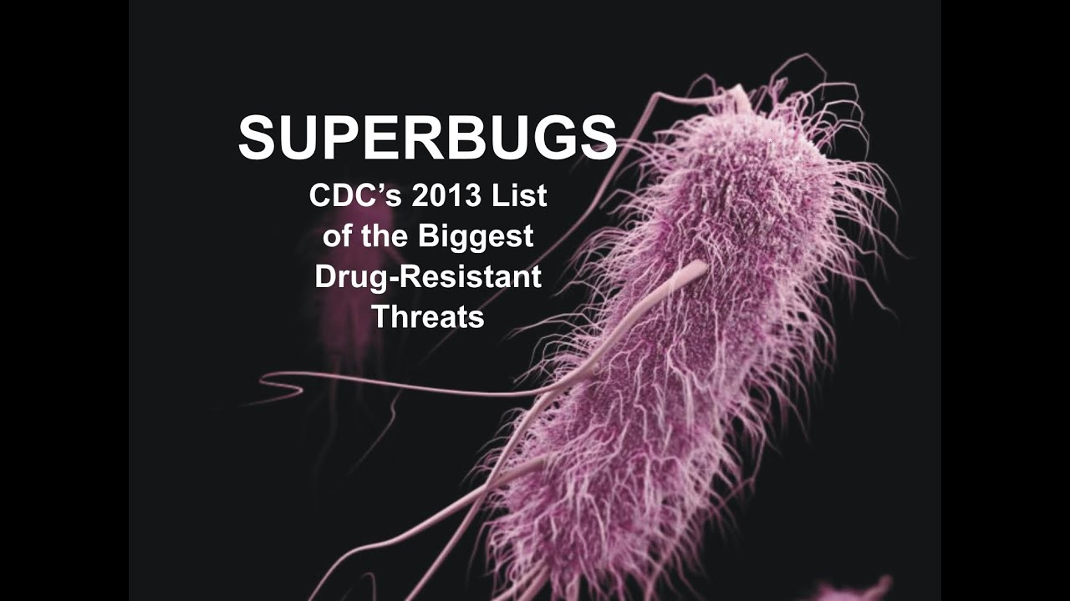

Strong Need for Drug Innovation
Drug innovation is very important
In total there are about 30,000 diseases caused by various bacteria and viruses and only around 1/3 of them can be treated
A typical drug takes about 10 years and costs about $2B to produce
Complexity
Human biological system involves a combinatorial space of more than 10⁶⁰ molecules
COVID-19
Antibiotic-resistant
“superbugs” (2013)
Ebola outbreak
(2014-2016)

Slide 100
AI in BioPharma
An AI system’s “ability to correctly interpret external data, to learn from such data, and to use those learnings to achieve specific goals and tasks” is critical (Kaplan and Haenlein 2019)
What is the effect of AI on drugs?
How do we use AI to exploit data about known drug compounds and predict whether a compound can be developed into a drug that humans can consume safely?

Slide 101
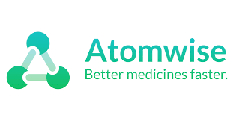
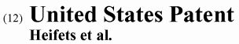
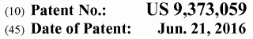
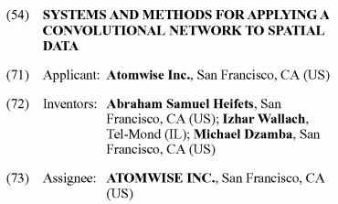
AI in BioPharma
Atomwise and other startups have developed complex, deep learning neural networks and deloyed them on the rich data we have about drugs
As a result, two new drug compounds were discovered for Ebola disease within one week

Slide 102
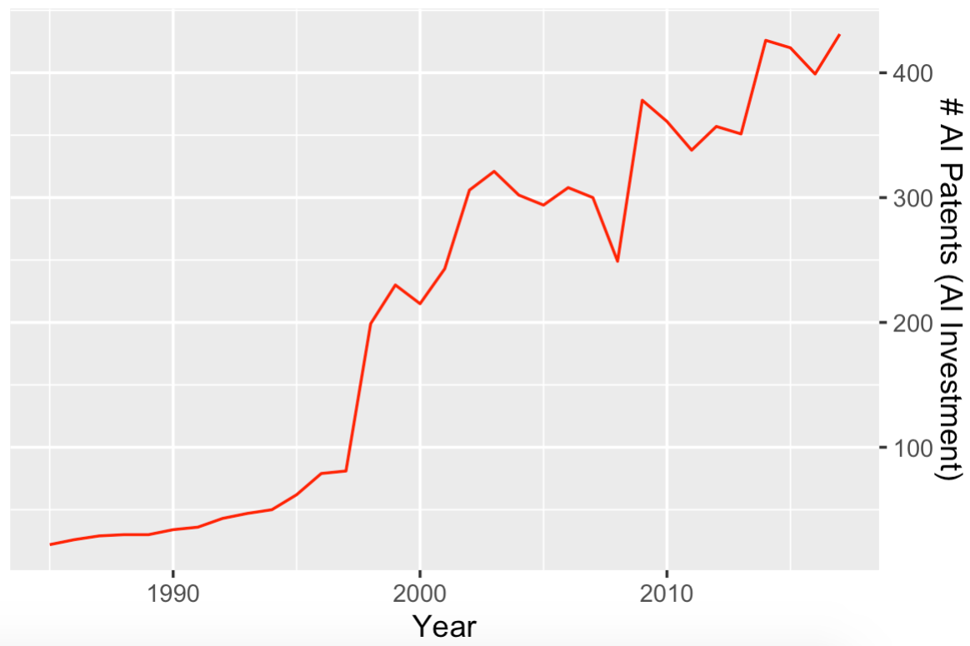
AI Investment in BioPharma
AI Investment in BioPharma
# AI Patents (AI Investment)
Year

Slide 103
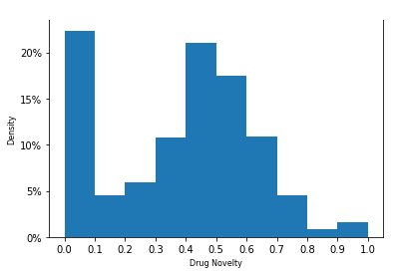
Results - AI & Drug Novelty
ln(# of Drugs)_{it} = β₀ + β₁AI Innovation Capability_{it} + y_{i} + γ_{t} + Controls_{it} + Error_{it}
Incremental
0.00255
(0.00160 )
Medium novel
0.017***
(0.0040 )
Brand new
0.0027
(0.0020)
Note: *** p<0.01, ** p<0.05, * p<0.1

Slide 104
Impact of Known and Unknown Mechanism
No known
mechanism
Known
mechanism
Known
mechanism
& incremental
Known
mechanism
& medium novel
Known
mechanism
& very novel

Slide 105
Main Takeaways
It is really hard to know which drug candidates are real and which ones are false
AI is a great data mining machine, finding all kinds of correlations and hidden patterns you didn’t see before
A new way of combining things in a new way
In terms of finding novel drug compounds, the effect is relatively minimal
The mechanism impact can help you to discern between spurious correlation and true causation

Slide 106

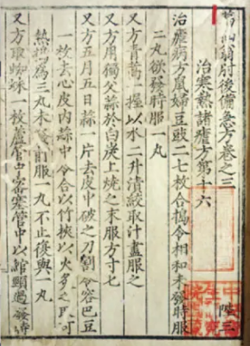

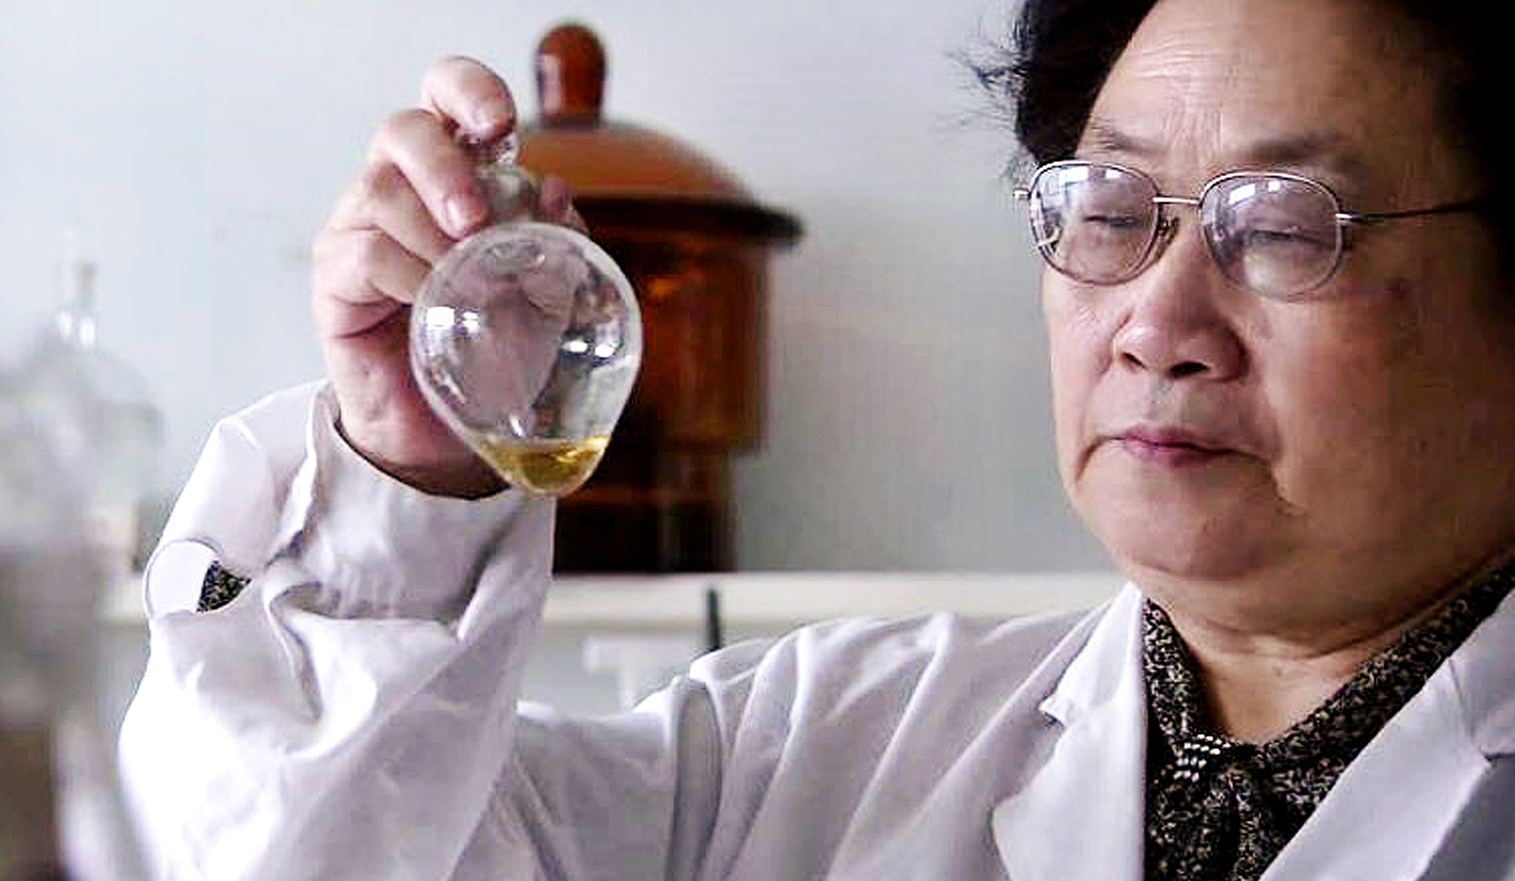
Limited Data and Tacit Knowledge
Limited data
Tacit knowledge
Novel therapy for malaria
Discovered by Dr. Youyou Tu, 2015 Nobel Prize

Slide 107
Pure AI Skills vs. Hybrid AI Skills

Slide 108
Takeaways
AI can help drug discovery at the very early stages, in the compound discovery stage
This effect is especially strong when you already know what the mechanism of that drug is
AI helps drug discovery for intermediately novel compounds, similar to recombination in innovation
For really novel drug therapy, it’s still limited use because there isn’t enough data
Much of that development still relies on human ingenuity

Slide 109


